Slide 1
Store management system
Created by : Shobhit dixit , vikram chaurasia and Siddharth garg

Slide 2
Objective of Existing System
The Store Management in early years when they are not computerised were difficult to be managed and requires daily observation of the product they possess. The information about product was recorded in the files or on paper.
In this proposed store management system all the requirements has been added which makes the shopkeeper to perform all their tasks by their own such as knowing details of daily transactions, preparing balance sheet and knowing details of each products under their shop by just one click. Each customers will have a unique bill id and product id along with the description of product such as model number, name, number of quantities, price of each product, total price along with the date and time.

Slide 3
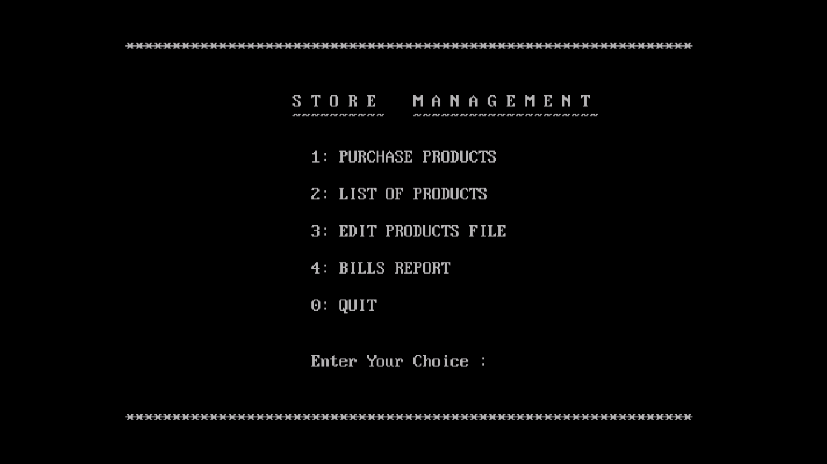
main Menu

Slide 4
Edit menu
It’s very hard for the shopkeeper to remember their cost price and in what price these items to be sold. As the market goes up and down for various products daily, so there should be some proper medium through which prices of these items can be changed frequently without any problem.
The Store management system will enable its user’s keep their customers report secure, so that next time these customers when arrive to their shop, do not have to enter their details again. Buyers will also able to select products options while purchasing through computer screen and can make their payment from that particular screen and pick up their materials which they have selected at the pickup center within the shop.

Slide 5
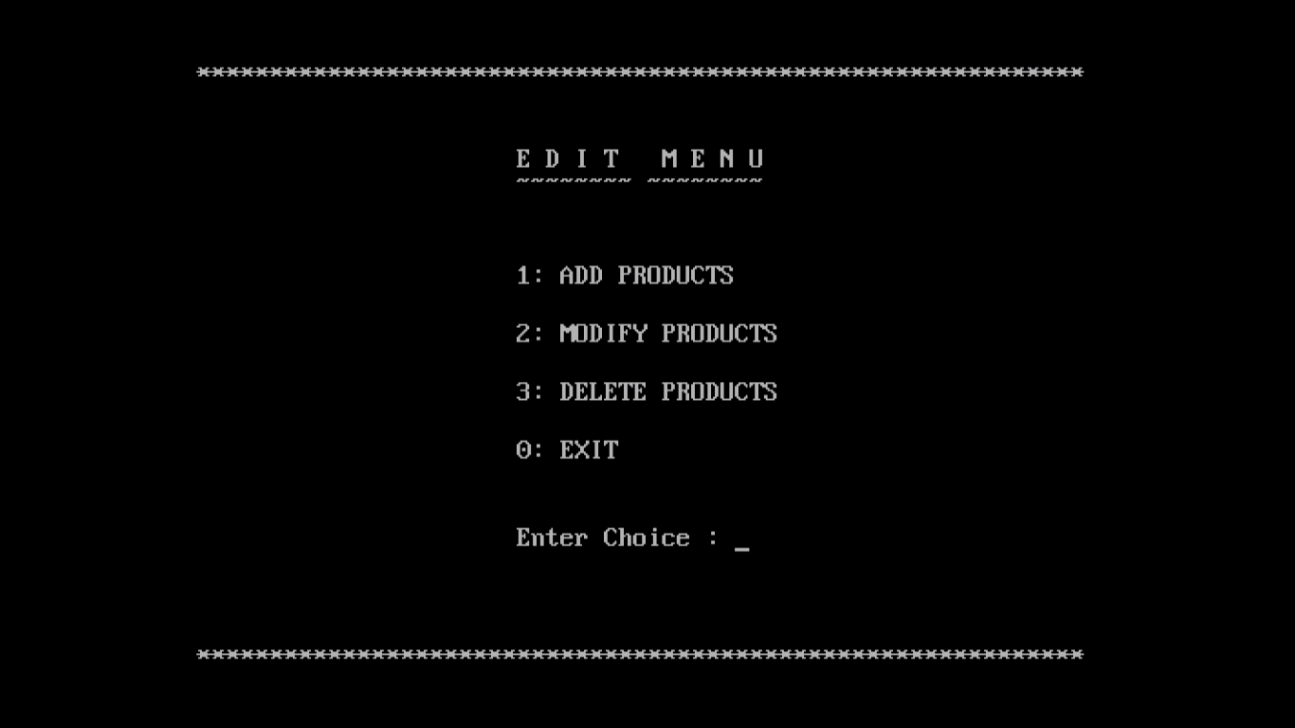
EDIT MENU

Slide 6
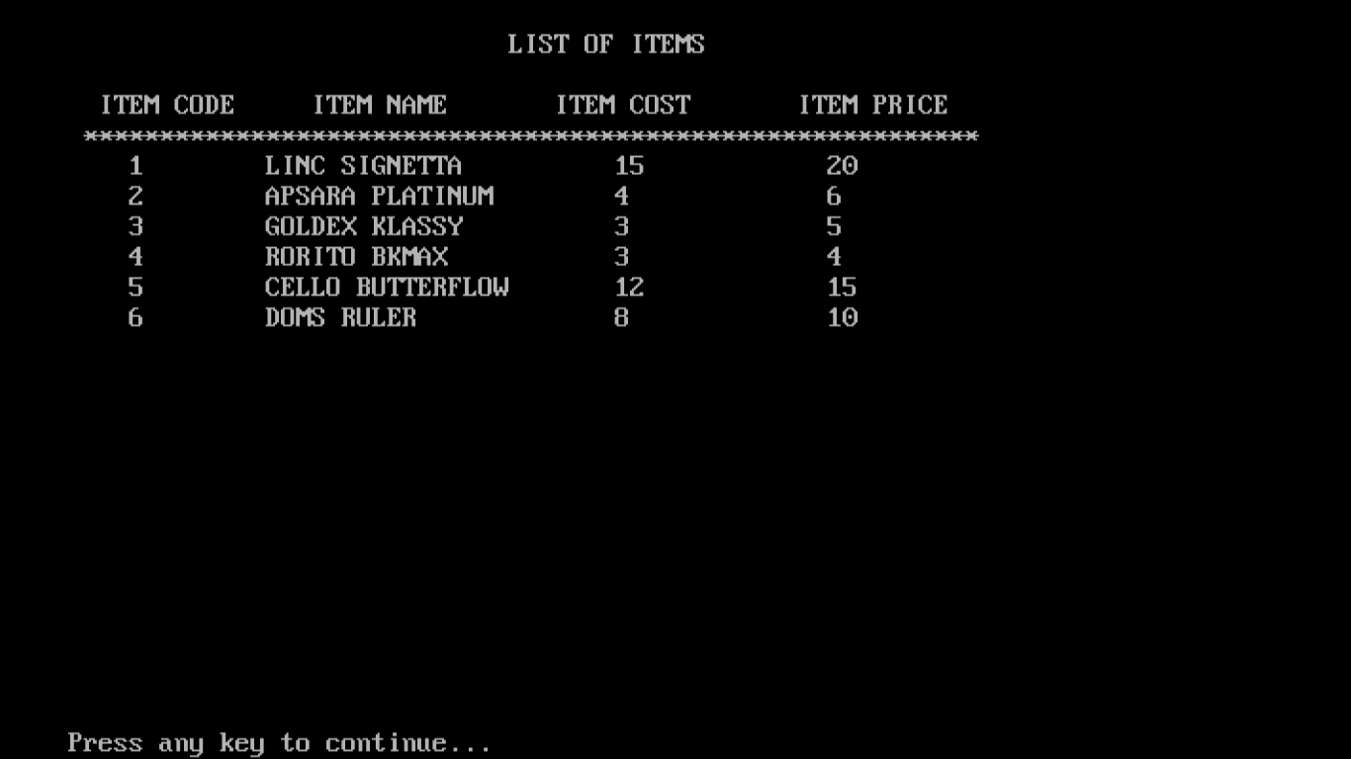
LIST OF ITEMS

Slide 7
Feasibility
A. Economic feasibility:
With the new system, the load of large employment and large number of employees can be reduced. Since, the system is capable of doing work, thus there is need of only few people who can handle the system.
B. Operation feasibility:
The new system can allow to do lot of operations. We can feed large number of data and search for any data when required. Bills are being calculated as quickly as possible and without any error. With the help of some operations we can form overall report of the records present in the system.

